Slide 1
Ancient Egypt
Religious Beliefs

Slide 2
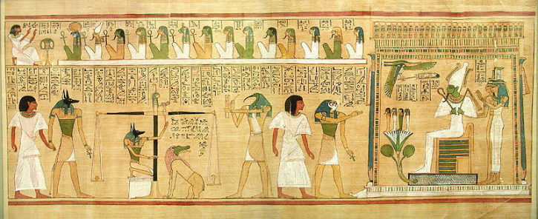
3500 years ago the people of Egypt had very different beliefs to other religions.
They believed in the afterlife.
They also believed in many different Gods.

Slide 3
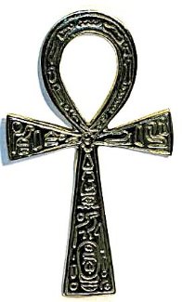
Ancient Egyptians believed that humans were made up of two parts.
Physical and Spiritual.
They believed that when you die all the spiritual parts of the body are released.
The Ankh – Ancient Egyptian religious symbol representing 'eternal life'

Slide 4
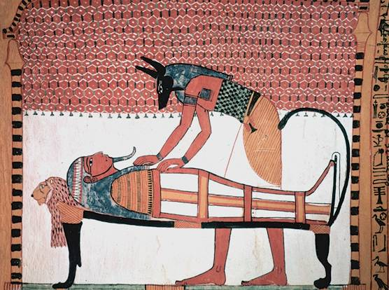
However, the Ancient Egyptians believed that the spirit needed a physical 'home' to come back to. This could be a special statue or the persons body.
People were mummified to preserve their body so that it would be a 'home' for their spirit.

Slide 5
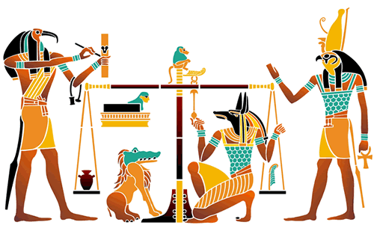
The final part of passing into the afterlife was to have your heart weighed against 'the feather of truth' by Anubis.
If the scales balanced then the God Osiris would greet you into the afterlife. However, if the scales didn't balance then Thoth would judge you and you would be eaten by a monster that was part lion, crocodile and hippopotamus.

Slide 6
Ancient Egyptian Gods

Slide 7
In ancient Egyptian times, gods were extremely important
in making the country run properly so the Egyptians
worshipped gods for just about everything- flooding, health, love, having babies, the sun, the sky and so on.
There were over 2000 gods- that’s a lot more than all of the gods in all of the different religions that exist nowadays! The gods were male, or female (goddesses) and were often shown as having the body of a human and the head of an animal or bird.
Can you imagine trying to remember 2000 names and their job?!

Slide 8


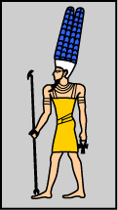
Amun
Was one of the most important gods in ancient Egyptian history. He was know as the ‘King of the Gods’
Amun was depicted in two different ways, in one, he had the head of a ram, in the other, he had a headdress made of ostrich feathers.
At some point during the Egyptian times, Amun became even more powerful when he combined with the sun god, Ra. He then became Amun-Ra.
Amun has a temple which was built to honor him in Thebes.

Slide 9

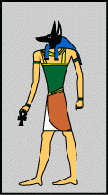
Anubis
Was the god of embalming (wrapping dead bodies in linin) and the dead.
Anubis was depicted in with a jackal head. The ancient Egyptians believed that Anubis watched over the dead because jackals were often seen in cemeteries.
Anubis watched over all of the mummification that took place in ancient Egyptian times. He helped to embalm Osiris after he was killed by Seth.
Priests often wore a mask of Anubis during the embalming process.

Slide 10


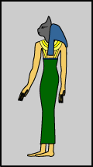
Bastet
Was a protective goddess.
Bastet, also known as Bast, had the head of a cat. However, at times of battle, she was depicted with a lioness’ head to protect the King, or pharaoh.
Bastet was usually a gentle goddess, and many ancient Egyptians had statues of cats to protect them. She was the daughter of Ra, the sun god.
A great temple was built in her honour at Bubastis in the Delta.

Slide 11

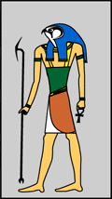
Horus
Was the god of the sky.
Horus had the head of a hawk and was believed to be living within the pharaohs.
He was the main protector of the king or queen of ancient Egypt.
Horus was believed to be the son of Isis and Orisis. He was believed to have lost one of his eyes whilst battling against Seth for the throne.
One of the best-preserved temples in Egypt today was dedicated to Horus. It is located in Upper Egypt at a town called Edfu

Slide 12

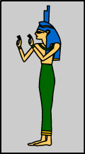
Isis
Was a protective goddess who used spells to protect.
Isis was depicted in two ways, having a throne shaped headdress, and having cows horns with a sun between them. She used powerful magic spells to help people in need.
Isis was the wife of Osiris and the mother of Horus. Since each pharaoh was considered the 'living Horus', Isis was very important. Isis is associated with thrones because her lap was the first 'throne' that Horus sat upon.
A temple was built to honour Isis at Philae. It is still standing today.

Slide 13

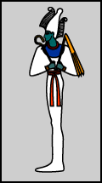
Osiris
Was the god of the dead and ruler of the underworld.
Osiris was shown to be a human who was mummified and wore a cone-like headdress with feathers. Osiris was also the god of resurrection and fertility.
The ancient Egyptians believed that Osiris gave them the gift of barley, one of their most important crops. Osiris was the husband of Isis, the protective goddess.
A large temple was built to honour Osiris at Abydos.

Slide 14

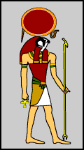
Ra
Was the sun god, and the most important of the ancient Egyptians.
Ra had the head of a hawk and wore a headdress which was formed of a ring of sun. Ra was believed to be swallowed up by the sky goddess, Nut each night and reborn each morning.
The ancient Egyptians also believed that he travelled through the underworld at night. In the underworld, Ra appeared as a man with the head of a ram.
There are a number of temples in Thebes and Luxor which
are dedicated to Amun Ra, but none just for Ra.

